Slide 1
Digital Portfolio
STUDENT NAME: SELVAM.T
REGISTER NO AND NMID: asunm287212401904
DEPARTMENT: BCA COMPUTER APPLICATION
COLLEGE: COLLEGE/ UNIVERSITY MADRAS UNIVERCITY

Slide 2
PROJECT TITLE
STUDENT PORTFILO

Slide 3


AGENDA
Problem Statement
Project Overview
End Users
Tools and Technologies
Portfolio design and Layout
Features and Functionality
Results and Screenshots
Conclusion
Github Link
3/21/2024 Annual Review

Slide 4

PROBLEM STATEMENT
In Today’s Competitive environment student needs a platform to demonstrate their skills, creativity, and achivements beyond grades. A portfilo helps bridge this gap by providing evidence of learning and accomplishments

Slide 5

PROJECT OVERVIEW
Breif Summary Of My Project
My Portfilo contain(about,projects,skills,contact
Main idea:to show my personal achivements, skills and projects
I have proceed all of my informations in this project
My project was create and usefull to know about my self

Slide 6

WHO ARE THE END USERS?
Student(academic,project,resumes,bio-data).
Jod Seekers(to share with recruiters).
Freelancers(ton show clients).
Researches(to showcase publication and research).
Artists(to present creative portfilo).
Educators(to pitch ideas and business models).

Slide 7

TOOLS AND TECHNIQUES
HTML -> Structure(pages,section).
CSS ->Styling(colors,layout,responsiveness).
JavaScript -> Interactivity(navigation menu,animation,form validation).
Mention code editers(VS CODE)orCODEPEN and hosting platform(GitHug pages).
Browser DevTools -> Debugging and performance Testing.
Git&GitHub ->Version control and collabrative development.

Slide 8
POTFOLIO DESIGN AND LAYOUT
Section included:
Hom/About me
Projects
Skills
Contact
Responsive layout (mobile + desktop view).
Consistence colour theme and typography
8

Slide 9
FEATURES AND FUNCTIONALITY
Navigation bar with smooth scrolling.
Project showcase with image/details
interactive element(hover effects, animations).
Contact form(with validation).
Responsive design for all devices.
Security measures(basic form spam protection).
Cross Browser compatiability (Chrome, Edge, Firefox, Safari).

Slide 10
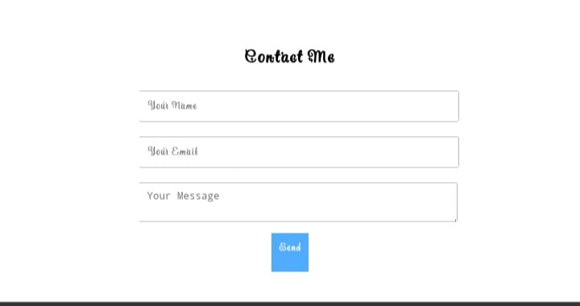
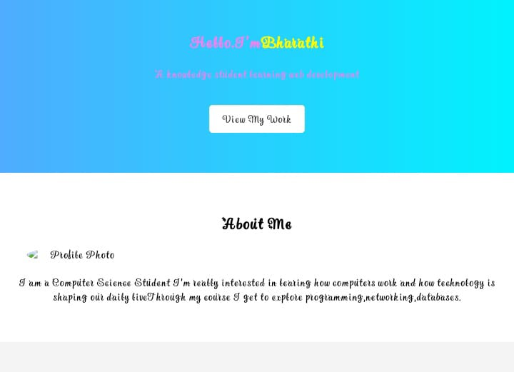

RESULTS AND SCREENSHOTS
3/21/2024 Annual Review
10

Slide 11
CONCLUSION
Highlights of my project
Final Summary
Benefits To society
Future Enhancement -> Scope of adding new features and improvements
Personal Growth -> Skills development(technical+soft skills)
Closing Statements -> Emphasis on the importance of digital portfilo in today’s world
11

